Slide 1
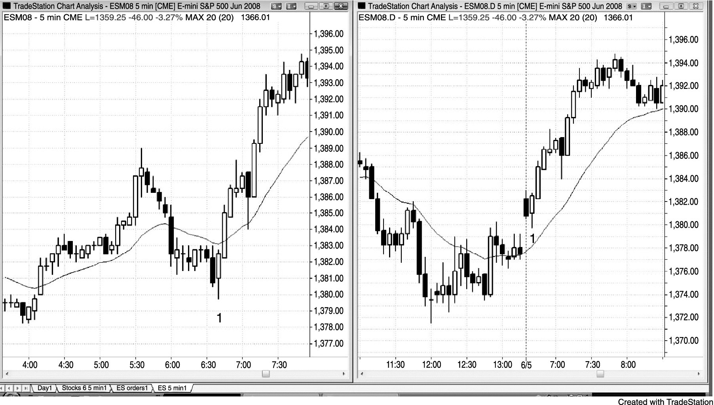
FIGURE 17.1 The Globex and Day Session Usually Give Related Signals

Slide 2
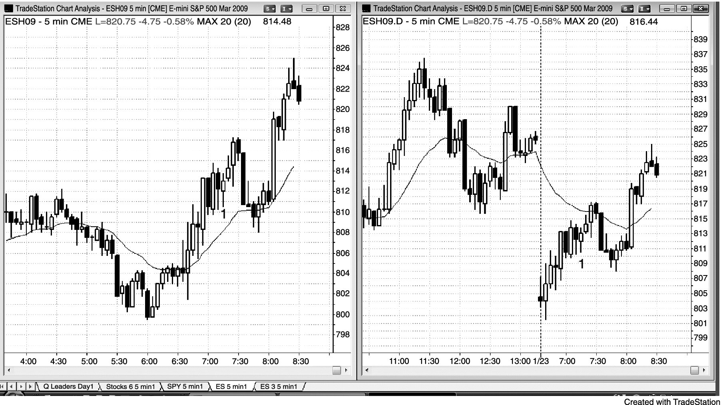
FIGURE 17.2 The Moving Average Is Different on the Globex

